Slide 1

Predicting Crime Incidents using Victim Characteristics, Location, and Time: A Case Study of Los Angeles From 2020-2024
By Patricia Magumise| Edward Paunganwa
IA 650: Masters in Applied Data Science | Clarkson University | January 2026

Slide 2

Crime in Los Angeles - Historical Overview
2020
2022
2023
2021
2024
207K
218K
245K
240K
187K
COVID-19 year
Crime suppressed
by lockdowns
During lockdown
Property crime peak
114,453 incident
Peak total crime
Highest since 2008
Slight decline
17% vs 2022
Significant drop
14% vs 2023
Introduction
Can we predict whether a crime will be violent or non-violent just by looking at who, where, and when it happened?
The FBI (2019) defines violent crimes as offenses involving force or threat of force.
In this project, we analyzed crime data from Los Angeles between 2020 and 2024 to uncover hidden patterns and build predictive models that can support smarter policing and safer communities.
Peeler (2025) argues non-violent crimes do not involve physical injury to another person.
The ability to predict whether a crime is violent or non-violent allows law enforcement to prioritize responses and deploy resources more effectively.
14.2%
Decrease in violent crime
2020 to 2024
Decrease in Non violent crime
2020 to 2024
6.0%
C
2
Clarkson university
Notes:
Public property crimes fell as people stayed home and public spaces emptied
Forced cohabitation increased domestic altercations

Slide 3
Research Framework and Dataset Overview
Dataset Source: data.gov Crime Data from 2020 to 2024 - Catalog
Initial Records:
1,004,992
After Cleaning:
733,886
Initial Variables:
28
Final Variables:
20
Target Variable:
Type of crime
LA Population:
3.86 million
Objective
Hypothesis (H₀)
Develop a model that predicts type of crime based on victim characteristics, location, and time of occurrence.
Victim characteristics, location, and time of occurrence do not significantly predict the type of crime.
Research Question
Aims
To what extent can victim characteristics, location, and time predict the type of crime?
Explore and analyze the distribution and patterns of crime type.
Examine the influence of victim characteristics, location, and time on crime type.
Support data-driven decision-making for law enforcement.
Evaluate model performance using accuracy, precision, recall, AUC-ROC.
C
2
Clarkson university

Slide 4
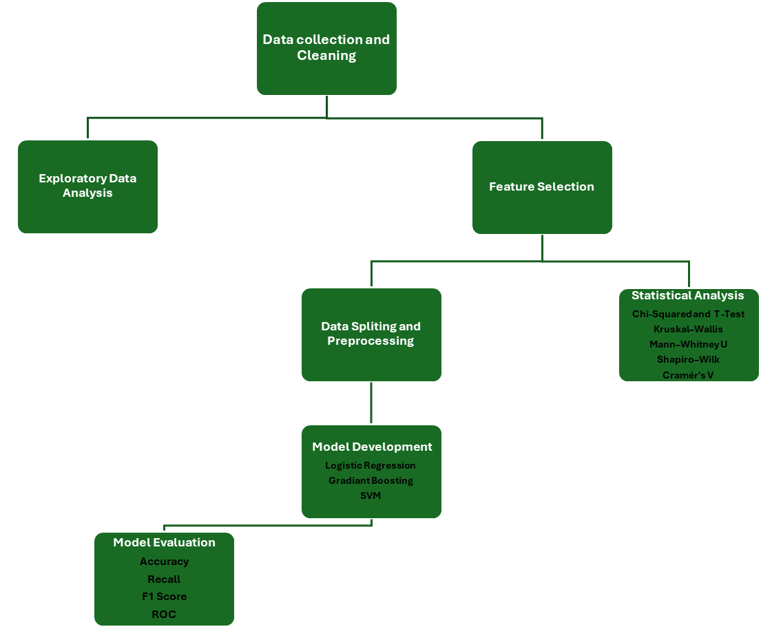
Methodology and Dataset Variable Description
C
3
Clarkson university

Slide 5
Methodology and Dataset Variable Description
Variable Name | Role | Type | Description
Date Reported | Predictor | Date | Date when the crime was reported
Date Occurred | Predictor | Date | Date when the crime occurred
Area Name | Predictor | Categorical (Nominal) | Name of the LAPD area referencing surrounding community
Reported District Number | Predictor | Categorical (Nominal) | Sub-area code with geographic significance
Crime Code | Predictor | Categorical (Nominal) | Code identifying the crime committed
Crime Description | Predictor | Categorical (Text) | Description corresponding to the crime code
Victim Age | Predictor | Numerical (Continuous) | Age of the victim at the time of the crime
Victim Sex | Predictor | Categorical (Nominal) | Sex of the victim (Male, Female, Unknown)
Victim Descent | Predictor | Categorical (Nominal) | Victim's racial or ethnic descent
Premise Code | Predictor | Categorical (Nominal) | Numeric code identifying the type of premises
Premise Description | Predictor | Categorical (Text) | Description of premises where crime occurred
Serious Crime Code | Predictor | Categorical (Nominal) | Code for the primary and most serious crime
Latitude | Predictor | Numerical (Continuous) | Latitude coordinate of the crime location
Longitude | Predictor | Numerical (Continuous) | Longitude coordinate of the crime location
Hour Occurred | Predictor | Numerical (Discrete) | Time the crime occurred (24-hour format)
Victim Age Group | Predictor | Categorical (Ordinal) | Age group category of the victim
Type of crimes | Target | Categorical (Binary) | Classification as Violent or Non-Violent crime
Is night | Predictor | Categorical (Binary) | Whether crime occurred at night (1) or day (0)
Status | Predictor | Categorical (Nominal) | Code indicating status of the crime investigation
Year | Predictor | Numerical (Discrete) | Year the crime occurred
C
3
Clarkson university

Slide 6
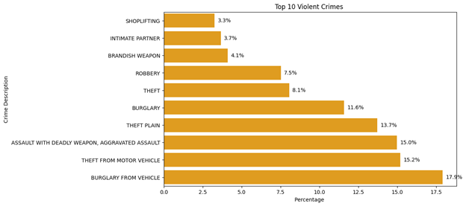
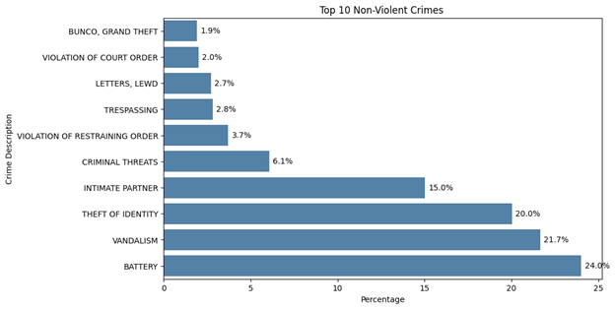
Crime Type Distribution
52.3%
47.7%
Violent Crimes -383,440 incidents
Non-Violent Crimes -350,446 incidents
Top Violent Crimes
Top Non-Violent Crimes
Burglary from Vehicle
Battery
Theft from Motor Vehicle
Aggravated Assault
Theft of Identity
Theft Plain
Intimate Partner
Burglary
C
6
Clarkson university
Notes:
Intimate Partner appears in both violent and non- violent crimes

Slide 7
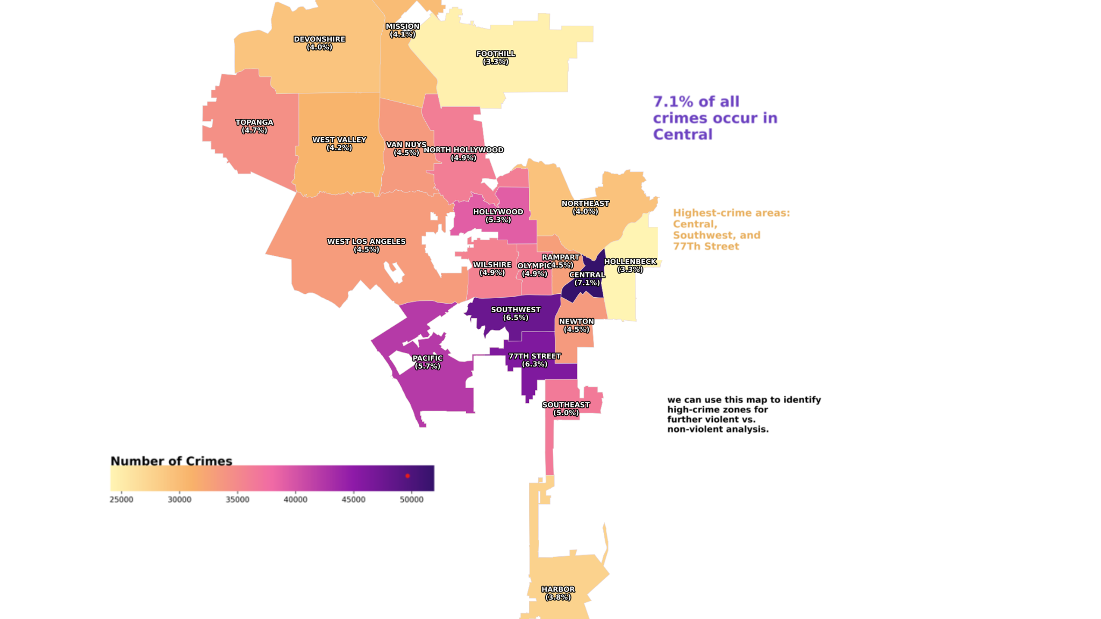
Spatial Analysis - Crime Distribution by Area
7.1%
77th Street
Hollywood
Pacific
C
Clarkson university

Slide 8
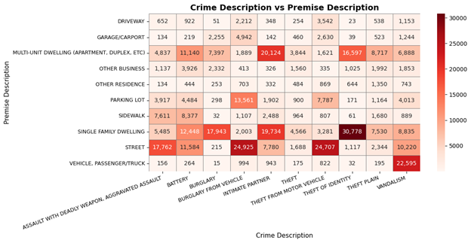
Crime Distribution by Premise Type
Pacific
C
Clarkson university
Notes:
Using Routine activity theory: certain premises (parking lots, streets, residences)generate specific crime types. A parking lot almost always produces vehicle theft, not assault. A residence almost always produces intimate partner violence or burglary. The premise essentially pre-determines the crime category.

Slide 9
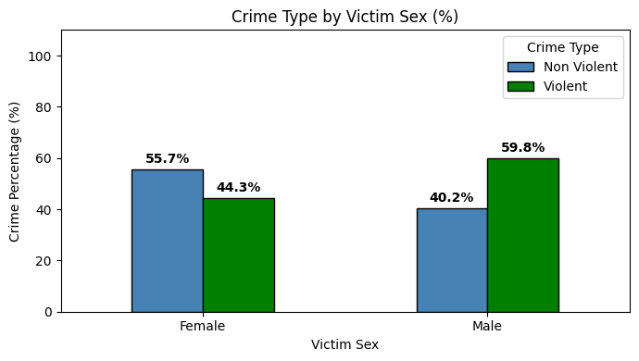
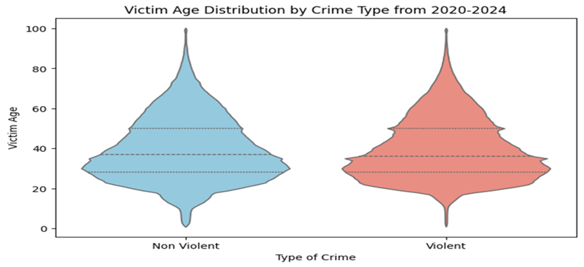
Victim Characteristics Analysis
Crime Victimization Compared to Population
Distribution by Descent
Descent Group | Population% | Victim% | Ratio
Hispanic | 48.8 | 39.6 | 0.81
white | 25 | 25.4 | 1.01
Black | 8.9 | 18.2 | 2.05
Asian | 16.4 | 5.4 | 0.33
Others | 5.6 | 9 | 1.61
C
10
Clarkson university

Slide 10
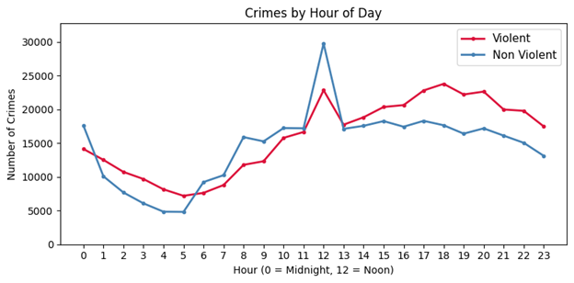
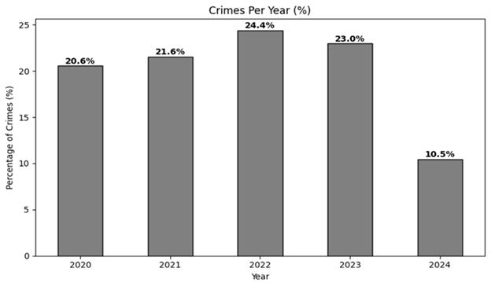
Temporal Patterns of Crime
of daytime crimes are non-violent
(vs 49% violent)
56%
of nighttime crimes are violent
(vs 44% non-violent)
51%
of daytime crimes are non violent(vs 49% violent)
C
8
Clarkson university

Slide 11
Statistical Analysis
Test | Variables | Statistic | Results | Alpha | P-Value | Cramér's V | Strength | Conclusion
Chi-Square | Victim Sex vs Crime Type | χ² = 17,222 | Significant | 0.05 | <0.001 | 0.154 | Weak | Association exists
Chi-Square | Time of Day vs Crime Type | χ² = 3,725.7 | Significant | 0.05 | <0.001 | 0.071 | Very Weak | Association exists
Chi-Square | Area Name vs Crime Type | χ² = 2,801.6 | Significant | 0.05 | <0.001 | 0.106 | Weak | Association exists
Chi-Square | Victim Descent vs Crime Type | χ² = 10,733.9 | Significant | 0.05 | <0.001 | 0.121 | Weak | Association exists
Chi-Square | Premise Description vs Crime Type | χ² = 120,368.9 | Significant | 0.05 | <0.001 | 0.405 | Strong | Association exists
T-test | Victim Age vs Crime Type | T = -0.44 | Not Significant | 0.05 | 0.664 | 0.083 | Very Weak | No significant association
Shapiro–Wilk | Victim Age | 0.964 | Significant | 0.05 | <0.001 | — | — | Victim Age is not normally distributed
Mann–Whitney U | Victim Age vs Crime Type | 66,925,981,546 | Significant | 0.05 | <0.006 | — | — | Significant difference between crime type
C
5
Clarkson university

Slide 12
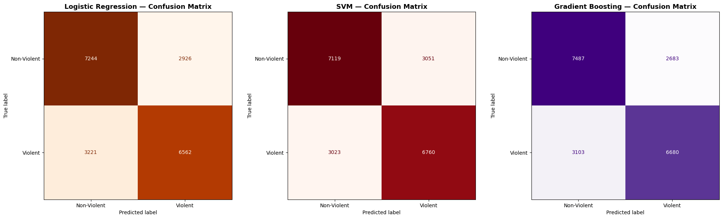
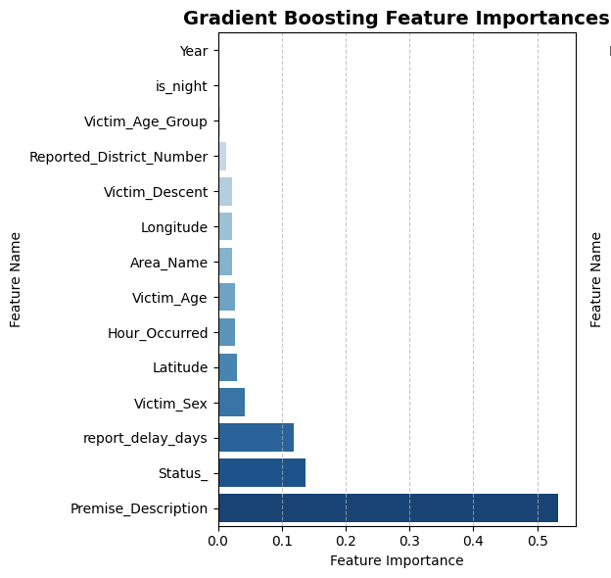
Model Performance Results
Model | Accuracy | ROC-AUC | CV Mean | CV Std | Precision | Recall | F1
Gradient Boosting | 0.7145 | 0.7847 | 0.7116 | 0.0069 | 0.71 | 0.71 | 0.71
SVM | 0.7014 | 0.7683 | 0.6999 | 0.0005 | 0.70 | 0.70 | 0.70
Logistic Regression | 0.6978 | 0.7595 | 0.6969 | 0.0004 | 0.69 | 0.69 | 0.69
C
11
Clarkson university

Slide 13
Discussion
Research Question Answer
Why Gradient Boosting Won
Victim characteristics, location, and time predict crime type at a moderate level (accuracy 70-71%), but are limited when considered independently. This answers our research question: predictive power exists but is not high.
Its iterative boosting mechanism corrects errors of prior trees, capturing non-linear interactions between features that logistic regression and SVM cannot model with linear decision boundaries.
Premise Description Dominates
Statistical vs Practical Significance
Cramér's V = 0.405 and GB importance score of 0.55 confirm that where a crime occurs matters more than who the victim is.
Routine activity theory
All variables were statistically significant (Chi-Squared) but Cramér's V showed weak practical associations for most. Large datasets (733K) inflate statistical significance effect size matters more.
Findings Align with Prior Literature
Limitations
Location as top predictor confirms Butt (2023).
No offender history, socioeconomic, or environmental features. Using victim descent raises predictive policing bias concerns (Gupta, 2024).
C
13
Clarkson university

Slide 14
Conclusion & Future Scope
Conclusion
Gradient Boosting is the best model
Location (premise description) is a stronger predictor than victim characteristics or time.
Violent crimes are more prevalent at night (56%); non-violent peak during midday.
Crime hotspots: Central LA (7.1%), Southwest, and 77th Street divisions.
Results support location-based policing strategies over demographic profiling.
Future Scope
Incorporating Time series Forecasting: Applying time series models such as ARIMA to predict future crime trends over months or years. This would help law enforcement anticipate crime patterns
Add socioeconomic features: Income, unemployment, housing density could improve classification ceiling
Real-Time Crime Prediction System: A real-time system can be developed using streaming data to provide live crime risk predictions for specific locations, helping police respond faster.
C
14
Clarkson university

Slide 15
Acknowledgement
Prof. Sumona Mondal
Co-Director, MS Program in Applied Mathematics | Clarkson University
We sincerely thank Prof. Mondal for her invaluable guidance, constructive feedback, and continued support. Her expertise in statistical modeling greatly contributed to the depth and rigor of this research.
Prof. Naveen Ramachandra Reddy
Assistant Professor, MS Applied Data Science | Clarkson University
We extend our heartfelt appreciation for his dedicated instruction, thoughtful mentorship, and knowledge imparted throughout this course. His guidance in applied data science and machine learning was fundamental to the successful completion of this study.
LAPD & data.gov
Los Angeles Police Department | U.S. Government Open Data Portal
We are grateful for making the LAPD crime dataset publicly available, without which this research would not have been possible.
C
16
Clarkson.

Slide 16
Thank you!
Edward Paunganwa | Patricia Magumise
Questions & Discussion

